Slide 1
IBM Hackathon
Creative Thinking
Analytical Thinking
Collaboration
Communication

Slide 2
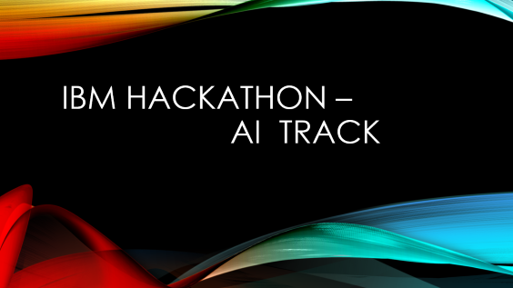
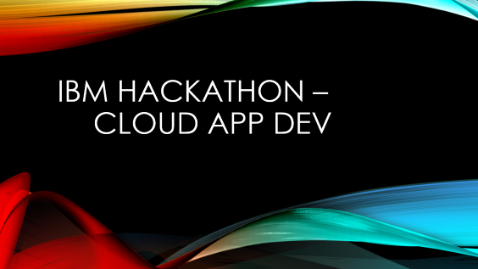
IBM Hackathon - Tracks

Slide 3
IBM Hackathon – Cloud App Dev

Slide 4
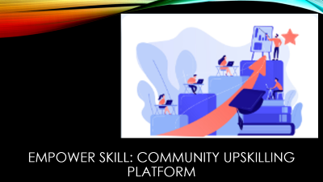


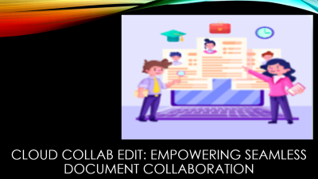
Topics Given

Slide 5
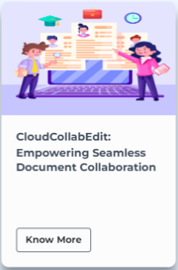
Cloud collab edit: Empowering seamless document collaboration

Slide 6
Expected Results
Cloud-Enabled Collaborative Document Editing Platform aims to provide a comprehensive solution for seamless and secure document collaboration. By leveraging the power of cloud technology, users will have instant access to their documents from anywhere in the world. Real-time collaboration features such as simultaneous editing, comments, and track changes will facilitate efficient teamwork and eliminate version control issues.
Our platform will also address geographical constraints by enabling remote collaboration, allowing teams and individuals to work together seamlessly regardless of their physical location. By breaking down barriers and enhancing communication and collaboration, our platform will boost productivity and efficiency.
Python
IBM Cloud
Redhat openshift
IBM cloud object storage
Docker
Kubernetes

Slide 7
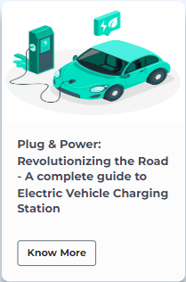
Plug & Power: Revolutionizing the road – a complete guide to electric vehicle charging station

Slide 8
Expected Results
The Plug & Power project aims to empower electric vehicle owners by providing them with accurate, real-time information about charging stations, making the transition to electric mobility smoother and more convenient. By encouraging the use of electric vehicles and facilitating access to charging infrastructure, we strive to contribute to a greener and more sustainable future on the roads. We can store the particular user data for the charge like the charging station name, billing, charging type, how much time it too to charge. We can also provide user with the information that if user want to reach to a particular charging station will the current battery be enough to take the user on that location.
Python
IBM Cloud
Redhat openshift
IBM cloud object storage
Docker
Kubernetes

Slide 9
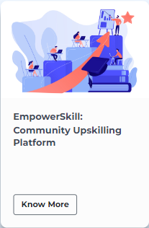
Empower skill: community upskilling platform

Slide 10
Expected Results
EmpowerSkill aims to address these challenges by creating a comprehensive community upskilling platform that offers relevant, affordable, and easily accessible resources, fosters collaboration among community organizations and educational institutions, and provides personalized support to empower individuals and bridge the skills gap within communities. It's expected to have features like:
1. User Profiles: Users can create profiles highlighting their skills, expertise, and areas of interest. They can also specify the skills they want to learn or improve upon.
2. Skill Listings: Users can list the skills they have to offer and the skills they are looking to acquire. This creates a searchable database of skills within the community, making it easy to find suitable skill exchange partners.
3. Skill Matching and Messaging: The application suggests potential matches based on users' listed skills and desired skills. Users can send messages to connect, discuss their skill exchange goals, and arrange meetings or online sessions.
4. Skill Exchange Sessions: SkillSwap provides a platform for users to organize in-person or virtual skill exchange sessions. These sessions can be one-on-one or group-based, depending on the preferences of the participants.
5. Reviews and Ratings: After each skill exchange session, users can provide feedback and ratings to rate the quality and effectiveness of the session. This feedback system helps build trust and ensures the credibility of the skills listed by users.
6. Community Forums and Events: The application includes community forums where users can engage in discussions, ask questions, and share resources related to various skills and interests. It also highlights local skill-sharing events and workshops happening in the area.
7. Skill Badges and Achievements: SkillSwap rewards users with badges or achievements for their active participation and successful skill exchanges. These achievements can be showcased on their profiles, adding a gamification element and motivating users to continue learning and sharing their skills.
8. Skill Resources: SkillSwap provides a repository of resources, such as tutorials, online courses, and recommended books or websites, to support users in their skill development journey. These resources can be curated by the community or provided by trusted sources.
Python
IBM Cloud
Redhat openshift
IBM cloud object storage
Docker
Kubernetes

Slide 11

Health Connect: Streamlined Doctors Appointment and Health Record Management

Slide 12
Expected Results
The Expected solution should have the following key features:
Appointment Scheduling: Effortlessly book appointments with doctors, specialists, and healthcare facilities directly from the app. Check real-time availability, select suitable time slots, and receive instant confirmation for your appointments.
Doctor Recommendations: Discover healthcare providers based on your location, specialty preferences, and patient reviews. Access detailed profiles that include qualifications, experience, areas of expertise, and other relevant information to make informed decisions.
Health Record Management: Digitize and store your medical records securely in one place. Easily manage and access your health history, including diagnoses, medications, allergies, lab results, and immunizations. Maintain a comprehensive overview of your health journey. User will be able to control doctor's access to their profiles
Prescription Management: Capture and store digital copies of your prescriptions, making it easy to manage and refill medications. Receive automated reminders for medication doses, ensuring you never miss a dose.
Personal Health Tracker: Monitor and track your health metrics, such as blood pressure, weight, glucose levels, and more. Visualize trends and set personalized health goals to proactively manage your well-being.
Python
IBM Cloud
Redhat openshift
IBM cloud object storage
Docker
Kubernetes

Slide 13
Expected Results
Appointment Scheduling:
Doctor Recommendations:
Health Record Management:
Prescription Management:
Personal Health Tracker:
Effortlessly book appointments with doctors, specialists, and healthcare facilities directly from the app. Check real-time availability, select suitable time slots, and receive instant confirmation for your appointments.
Discover healthcare providers based on your location, specialty preferences, and patient reviews. Access detailed profiles that include qualifications, experience, areas of expertise, and other relevant information to make informed decisions.
Digitize and store your medical records securely in one place. Easily manage and access your health history, including diagnoses, medications, allergies, lab results, and immunizations. Maintain a comprehensive overview of your health journey. User will be able to control doctor's access to their profiles
Capture and store digital copies of your prescriptions, making it easy to manage and refill medications. Receive automated reminders for medication doses, ensuring you never miss a dose
Monitor and track your health metrics, such as blood pressure, weight, glucose levels, and more. Visualize trends and set personalized health goals to proactively manage your well-being.
Python
IBM Cloud
Redhat openshift
IBM cloud object storage
Docker
Kubernetes

Slide 14
IBM Hackathon – AI Track

Slide 15

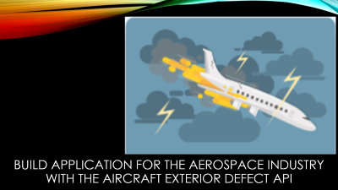
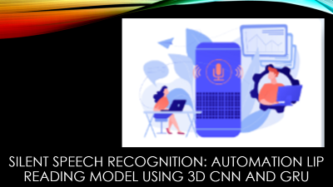

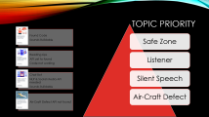
Topics given

Slide 16

Safe Zone: real-time video Analytics for Industrial safety

Slide 17
Expected Solution
The objective is to leverage Deep Learning techniques to monitor live video feeds and provide real time hazard detection, prompt alerts, and interventions, enhancing industrial safety and preventing accidents in industrial environments.
Python
Artificial Intelligence
Deep Learning
Object Detection
Yolo
Flask

Slide 18
Expected Solution
Python
Artificial Intelligence
Deep Learning
Object Detection
Yolo
Flask
Monitor Live Video Feeds
Real Time Hazard Detection
Prompt alerts and Interventions
Enhancing Industrial Safety
Website to input these live video feeds
And generate output as below

Slide 19
Required Skills
1
2
3
4
Safe Zone
Silent Speech
Listner
AirCraftDefect
Python
Artificial Intelligence
Deep Learning
Object Detection
Yolo
Flask
Artificial Intelligence
Deep Learning
Machine Learning
Python
Flask
Web Development
Advance AI Models
IBM Watson Studio
NLP
NLTK
Python
IBM Watson Assistance
Flask
Artificial Intelligence
Python
Object Detection
Artificial Intelligence
Computer Vision
Advance AI Models
IBM Watson Studio

Slide 20
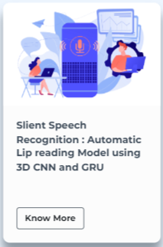
Silent speech recognition: automation lip reading model using 3d cnn and gru

Slide 21
Expected Solution
The objective is to create a data-driven solution using a combination of:
Convolution Neural Network (CNN)
Gated Recurrent Units
To accurately the speech form visual cues of lip movements captured in video data. The successful solution will provide an accurate and efficient silent speech recognition system that can interpret speech from visual cues of lip movement. It has the potential to revolutionize the communication, accessibility, and human-machine interaction in various domains, making it a versatile technology with wide ranging applications.
Artificial Intelligence
Deep Learning
Machine Learning
Python
Flask
Web Development
Advance AI Models
IBM Watson Studio

Slide 22
Expected Solution
Input Video/Live Video
Analyse in Website
Output speech
Visual cues of lip movements captured in video data.
These visuals can be Live or pre-recorded.
Combination of 3D-CNN and GRU is advised.
After analysis, a text should be provided, which conveys the message after analysing lip movements.
Artificial Intelligence
Deep Learning
Machine Learning
Python
Flask
Web Development
Advance AI Models
IBM Watson Studio

Slide 23
Required Skills
1
2
3
4
Safe Zone
Silent Speech
Listner
AirCraftDefect
Python
Artificial Intelligence
Deep Learning
Object Detection
Yolo
Flask
Artificial Intelligence
Deep Learning
Machine Learning
Python
Flask
Web Development
Advance AI Models
IBM Watson Studio
NLP
NLTK
Python
IBM Watson Assistance
Flask
Artificial Intelligence
Python
Object Detection
Artificial Intelligence
Computer Vision
Advance AI Models
IBM Watson Studio

Slide 24
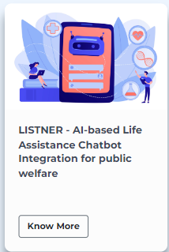
Listner – ai-based life assistance chatbot integration for public welfare

Slide 25
Expected Solution
The expected solution should have the following features:
Fully function AI-powered Chatbot capable of providing assistance and support in multiple areas.
Backend infrastructure developed using Flask, enabling seamless integration and communication with the chatbot.
Integration of either WhatsApp or Telegram API to facilitate user interactions through popular messaging platforms.
Integration of OpenAI GPT or similar NLP API for effective understanding and response generation based on user queries.
Implement of sentiment analysis API to extract emotional insights from conversations and deliver empathetic and personalized support.
Integration of the Twilio API or a similar solution for sending SMS or phone notification to support staff in critical situations.
Documentation providing guidelines for maintenance, deployment and further deployment of the chatbot.
NLP
NLTK
Python
IBM Watson Assistance
Flask
Artificial Intelligence

Slide 26
Expected Solution
NLP
NLTK
Python
IBM Watson Assistance
Flask
Artificial Intelligence
Fully function AI-powered Chatbot capable of providing assistance and support in multiple areas.
Backend infrastructure developed using Flask, enabling seamless integration and communication with the chatbot.
Integration of either WhatsApp or Telegram API to facilitate user interactions through popular messaging platforms.
Integration of OpenAI GPT or similar NLP API for effective understanding and response generation based on user queries.
Implement of sentiment analysis API to extract emotional insights from conversations and deliver empathetic and personalized support.
Integration of the Twilio API or a similar solution for sending SMS or phone notification to support staff in critical situations.
Documentation providing guidelines for maintenance, deployment and further deployment of the chatbot.

Slide 27
Required Skills
1
2
3
4
Safe Zone
Silent Speech
Listner
AirCraftDefect
Python
Artificial Intelligence
Deep Learning
Object Detection
Yolo
Flask
Artificial Intelligence
Deep Learning
Machine Learning
Python
Flask
Web Development
Advance AI Models
IBM Watson Studio
NLP
NLTK
Python
IBM Watson Assistance
Flask
Artificial Intelligence
Python
Object Detection
Artificial Intelligence
Computer Vision
Advance AI Models
IBM Watson Studio

Slide 28

Build application for the aerospace industry with the aircraft exterior defect api

Slide 29
Expected Solution
The Expected Solution should have feature like:
Application framework integrating the Aircraft Exterior Defect API and supporting user interactions and data management.
User-friendly interface allowing users to upload aircraft exterior images and initiate defect analysis.
Integration of the defect detection algorithms from the API to automatically identify and highlight potential defects on uploaded images
Image analysis algorithm and techniques are implemented to provide detailed defect information, including size, severity location, and potential causes.
Generation of comprehensive defect reports, including annotated images and recommended actions for repair or further investigation.
Database or Storage system for storing and organizing inspection records for future reference and analysis.
Security measure are implemented to protect the confidentiality and integrity of uploaded images and inspection data.
Scalable and robust application architecture capable of handling concurrent image uploads and processing requests.
Python
Object Detection
Artificial Intelligence
Computer Vision
Advance AI Models
IBM Watson Studio

Slide 30
Expected Solution
Python
Object Detection
Artificial Intelligence
Computer Vision
Advance AI Models
IBM Watson Studio
Application framework integrating the Aircraft Exterior Defect API and supporting user interactions and data management.
User-friendly interface allowing users to upload aircraft exterior images and initiate defect analysis.
Integration of the defect detection algorithms from the API to automatically identify and highlight potential defects on uploaded images
Image analysis algorithm and techniques are implemented to provide detailed defect information, including size, severity location, and potential causes.
Generation of comprehensive defect reports, including annotated images and recommended actions for repair or further investigation.
Database or Storage system for storing and organizing inspection records for future reference and analysis.
Security measure are implemented to protect the confidentiality and integrity of uploaded images and inspection data.
Scalable and robust application architecture capable of handling concurrent image uploads and processing requests.

Slide 31
Required Skills
1
2
3
4
Found Code
Sounds Buildable
Reading Lips
API yet to found
Chat Bot
NLP & Social Media API needed
Sounds Buildable
Air-Craft Defect API not found
Safe Zone
Silent Speech
Listner
AirCraftDefect
Python
Artificial Intelligence
Deep Learning
Object Detection
Yolo
Flask
Artificial Intelligence
Deep Learning
Machine Learning
Python
Flask
Web Development
Advance AI Models
IBM Watson Studio
NLP
NLTK
Python
IBM Watson Assistance
Flask
Artificial Intelligence
Python
Object Detection
Artificial Intelligence
Computer Vision
Advance AI Models
IBM Watson Studio

Slide 32
Topic Priority
Found Code
Sounds Buildable
Reading Lips
API yet to found
Code not working
Chat Bot
NLP & Social Media API needed
Sounds Buildable
Air-Craft Defect API not found
Safe Zone
Listener
Silent Speech
Air-Craft Defect

Slide 33
Required Skills
1
2
3
4
Safe Zone
Silent Speech
Listner
AirCraftDefect
Python
Artificial Intelligence
Deep Learning
Object Detection
Yolo
Flask
Artificial Intelligence
Deep Learning
Machine Learning
Python
Flask
Web Development
Advance AI Models
IBM Watson Studio
NLP
NLTK
Python
IBM Watson Assistance
Flask
Artificial Intelligence
Python
Object Detection
Artificial Intelligence
Computer Vision
Advance AI Models
IBM Watson Studio

Slide 34
Datasets Links
Dataset 1
Gloves
Goggles
Helmet
Mask

Slide 35
Architecture
Architecture
Monolithic Architecture
Micro-Service Architecture
Serverless Architecture
Peer – to – Peer

Slide 36
Architecture
Architecture
1 Tier
2 Tier
3 Tier
In - Tier

Slide 37
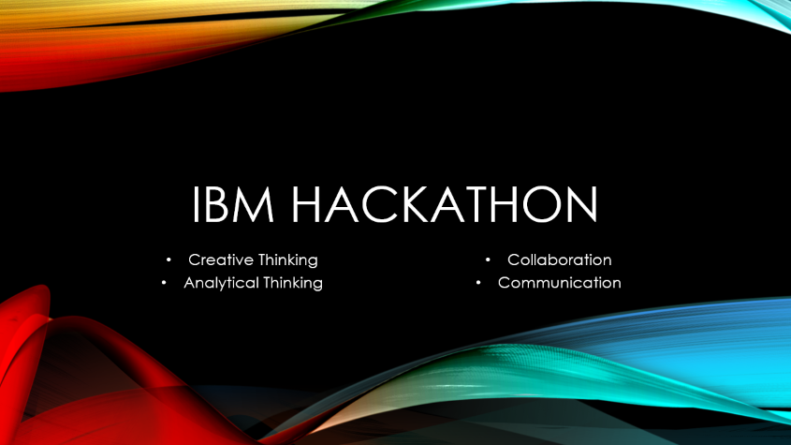
Summary

Slide 38
All the best guys
regards

